Slide 1
7.1.3
Facilities in the institution for the Management of the degradable and non-degradable waste

Slide 2
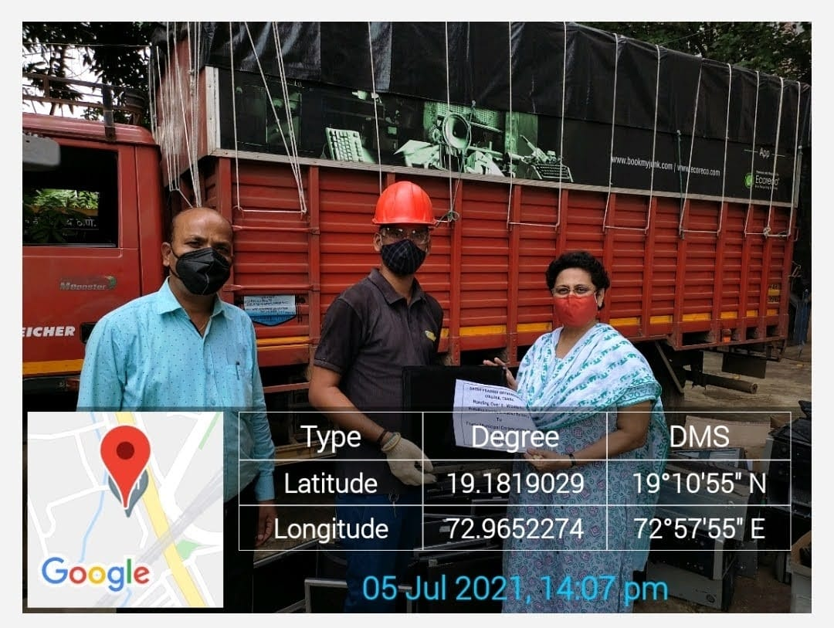
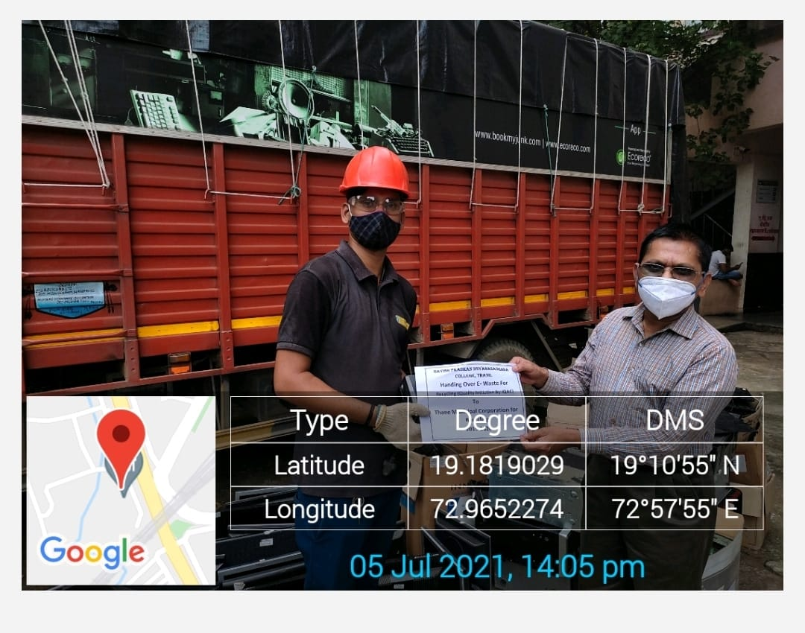
E- waste handing over to Thane Municipal Corporation

Slide 3
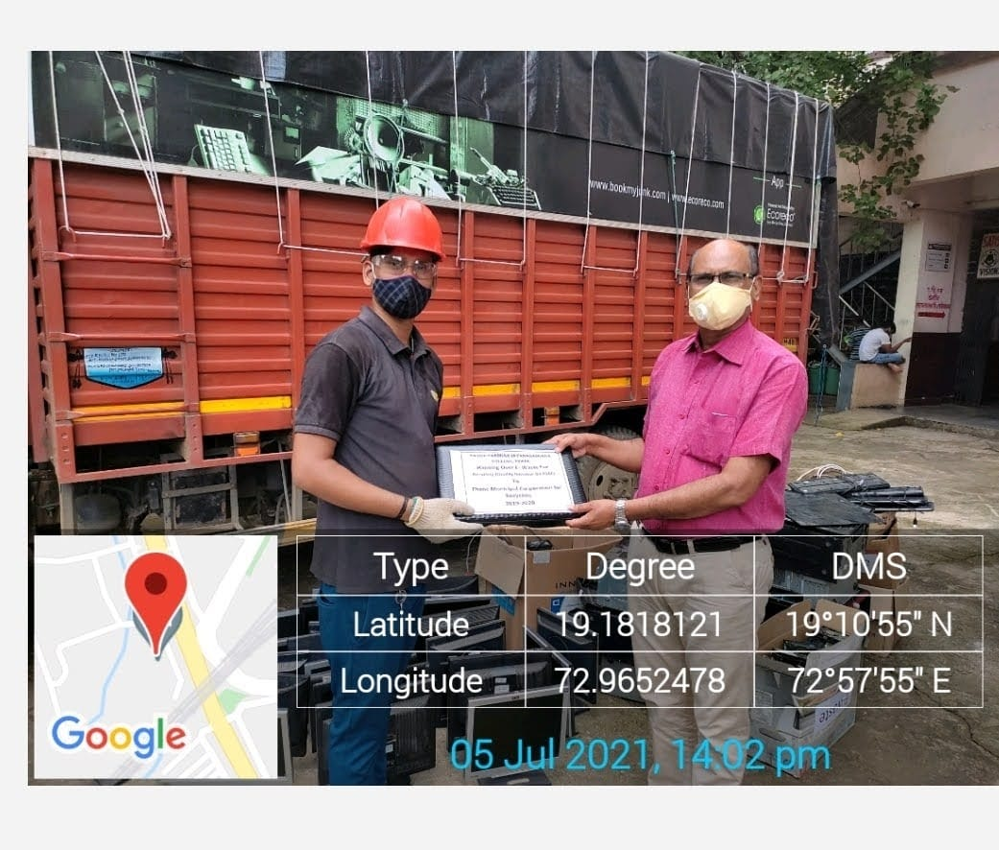
E-waste management

Slide 4
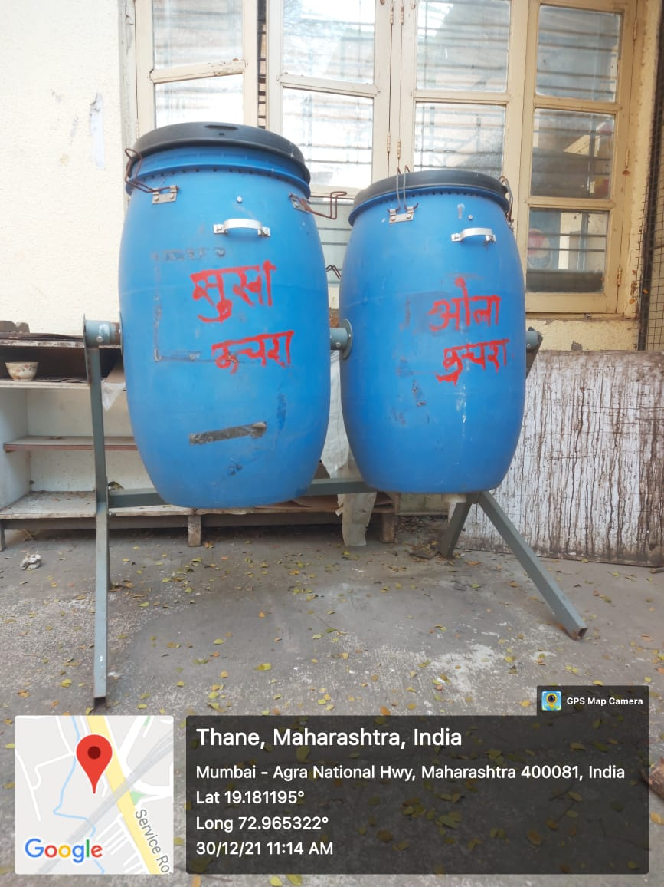
Solid waste Management

Slide 5
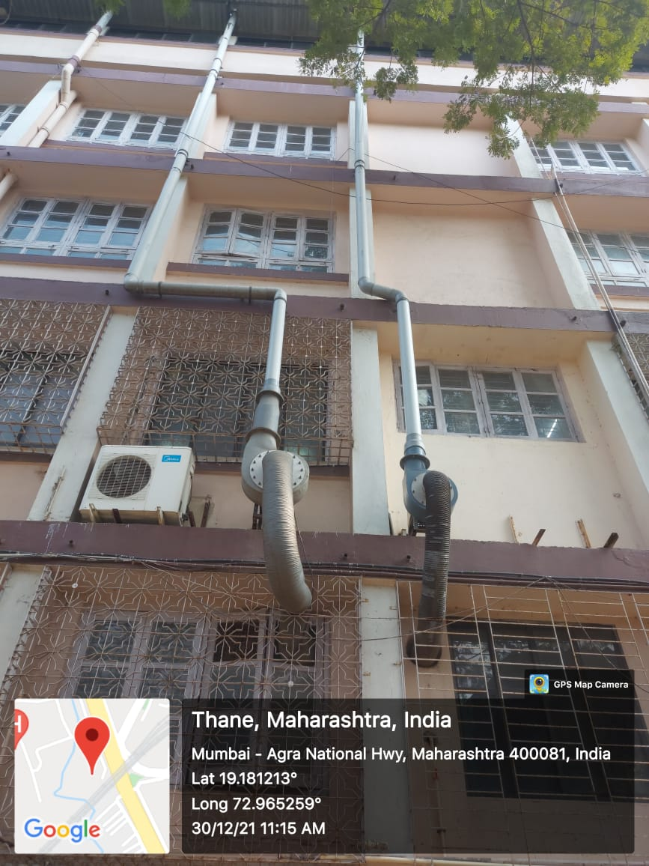
Hazardous chemical waste management – Fuminghood

Slide 6
These facilities have been clicked in the year 2021 as the college was closed due to the Covid Pandemic in the year 20-21. These facilities are there in the college since last NAAC Cycle.

